Slide 1

Automatic Distance Detection Two Moving Vehicles
Submitted By-
Atharva Dhabekar (S20180010050)
Hrishabh Pandey (S20180010064)
Sayam Kumar (S20180010158)
Siddhant Mohan (S20180010167)

Slide 2
Introduction -
Although there exists many different ways and technologies to detect distance between two moving vehicles, we have decided to use Doppler RADAR. Doppler RADAR works on the principle of Doppler effect. It does this by emitting a continuous microwave towards the target and determines the distance by analyzing the reflected signal.

Slide 3
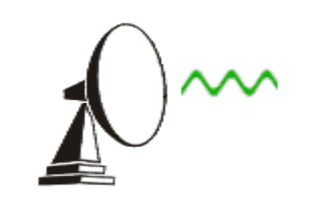
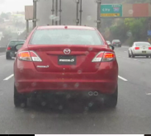
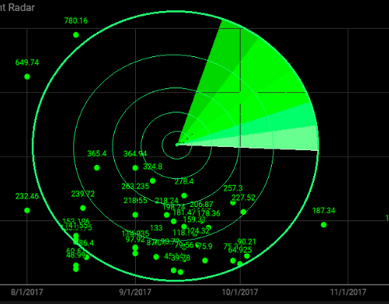
Flow Chart
Oscillator
Transmitter.
Display
Receiver.
Reflection of waves from obstacle

Slide 4
Distance Measurement Method-1
For measuring distance < 40 meters, radars can be fitted in front of the car. A short pulse is being transmitted by the radar and time is noted by the receiver. The distance is calculated by the simple formula
Speed = Distance / Time
then Distance = (Speed X Time)/2
where
Speed = speed of the radio wave transmitted. This speed is comparable to the speed of the light. So, the error is minimized.
Time = total time taken by the signal to bounce back to the receiver.
# Use of duplexer to make the radar switches between transmitter and receiver modes at a pre-determined rate.

Slide 5
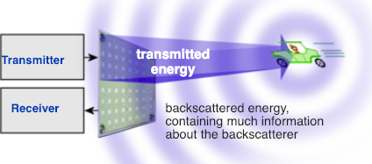
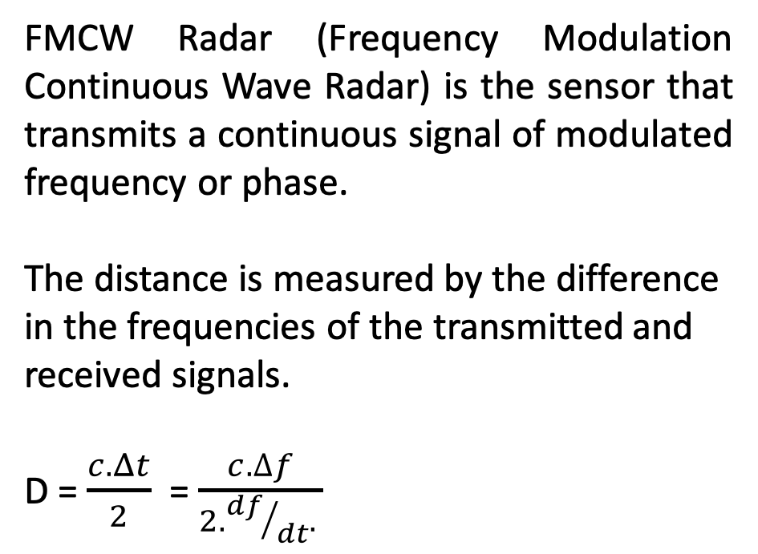
Method-2 Frequency Modulation
FMCW Radar (Frequency Modulation Continuous Wave Radar) is the sensor that transmits a continuous signal of modulated frequency or phase.
The distance is measured by the difference in the frequencies of the transmitted and received signals.
D = $\frac{c. Δt}{2}$ = $\frac{c.∆f}{2. {df}/{dt}. }$
c = speed of light = 3·10^{8 m}/_{s} Δt = delay time [s] Δf = measured frequency difference [Hz] D = distance between antenna and the reflecting object (ground) df/dt = frequency shift per unit of time

Slide 6
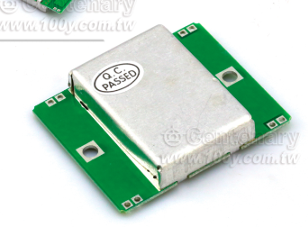
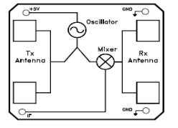
Hardware Requirements
The car will require a radar transmitter, receiver and HB100 module. The HB100 module is a doppler radar microwave motion sensor. This sensor can measure distances accurately up to 20m. It can only work with frequency 20GHz, so modulation is required.
To prevent accidents one may connect the sensor to the internal gears of the car such that the car slows down when danger is near.

Slide 7
Advantages
Long range detections.
Immune to extreme weather conditions.
Flexible mounting
Can be further used in-
Collision prevention
Driverless cars
Air defense systems
Marine radars
Determining the speed of vehicles around

Slide 8
Challenges
Noise -
Random variation superimposition on desired echo signal received in the radar receiver.
To avoid noise we can follow two approaches
we can improve our system to detect moving objects. This requires multiple scanning which will reduce noise.
The input from receiver can be spited and processed among multiple filters for pulse-Doppler-signal-processor, which uses number of filters to reduce the noise.
Clutter –
Radio frequency echo returned from target.
As clutter tend to appear static between radar scans, on subsequent scan desirable target will appear to move, and all stationary echo's can be eliminated.

Slide 9
References
en.wikipedia.org
www.radartutorial.eu
Amit Kumar Dimha “SPEED CONTROLING USING DISTANCE DETECTOR IN MOVING VEHICLE” Vol 2 Issue 5 Research Paper.
THANK YOU !

